Slide 1

Popular Built-in Functions (2)
Professor Bo Liu
James Watt School of Engineering

Slide 2
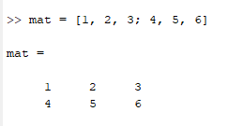


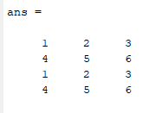
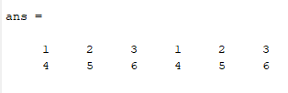
Tiling matrices
Tile (repeat) matrices using “repmat(mat, n, m)”.
  mat is the matrix to be tiled.
  Tiles n times vertically.
  Tiles m times horizontally.
See live script

Slide 3
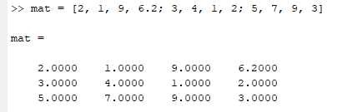
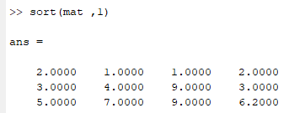
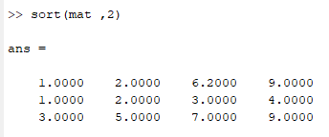
Sorting elements in matrices
MATLAB provides the sort() function to sort in ascending or descending order.
  Can specify a dimension along which to sort, by default sorts along columns.
  Can sort in descending order via a third argument: ‘descend’.
Sorting along columns (axis 1)
Sorting along rows (axis 2)
See live script

Slide 4
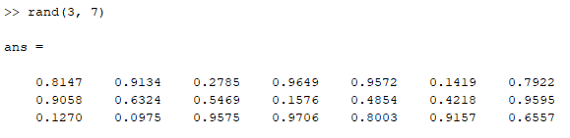
Uniformly distributed floating point numbers
Generate a matrix of n rows and m columns of uniformly distributed floating-point numbers using the “rand(n, m)” function.
  Note only pseudo random.
  Example, n = 3, m = 7.
See live script

Slide 5
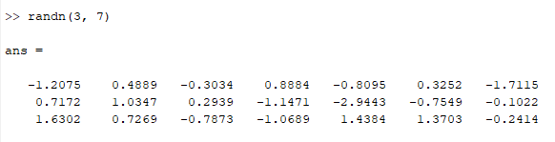
Normally distributed floating-point numbers
Generate a matrix of n rows and m columns of normally distributed floating-point numbers using the “randn(n, m)” function.
  Note only pseudo random.
  Example, n = 3, m = 7.
See live script

Slide 6
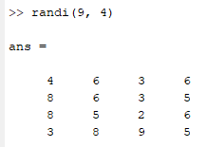
Uniformly distributed integers
Generate a matrix of n rows and columns of uniformly distributed integers between 1 and imax using the “randi(imax, n)” function.
  Note only pseudo random.
  Example, imax = 9, n = 4.
See live script

Slide 7




Thanks!
#UofGWorldChangers
@UofGlasgow

Slide 8
Pseudo random numbers
Generate uniformly random, normally distributed, or random integer permutations with built-in functions.
  Note, only pseudo random.
Function | Description
rand(m, n) | Creates a matrix of m rows and n columns where each element is a uniformly randomly distributed floating point number between 0 and 1.
randn(m, n) | Creates a matrix of m rows and n columns where each element is a Gaussian distributed random floating point number between 0 and 1.
randi(imax, n) | Creates a square matrix of n rows and columns with random integers between 1 and imax.
See live script

Slide 9
Other common functions
Function | Description
rem(a, b) | Returns the remainder when a is divided by b.
mod(a, b) | Returns the modulus when a is divided by b.
abs() | Returns the absolute value of the input.
These functions can also be used with matrices.
See live script

